Slide 1


Since 2011
Our outcomes are over 5000 trainees.
Get IT Right from RIG
Notes:
https://www.geeksforgeeks.org/python-programming-language-tutorial/

Slide 2

Python Django Project
installation
Learn, Create, and Shine
Digital Space

Slide 3
Courses
Python Basics
Python Functions
Python Data Structures
Python OOPs Concepts
Python Exception Handling
File Handling
Python Database Handling
Python Packages or Libraries
Web Development with Python

Slide 4
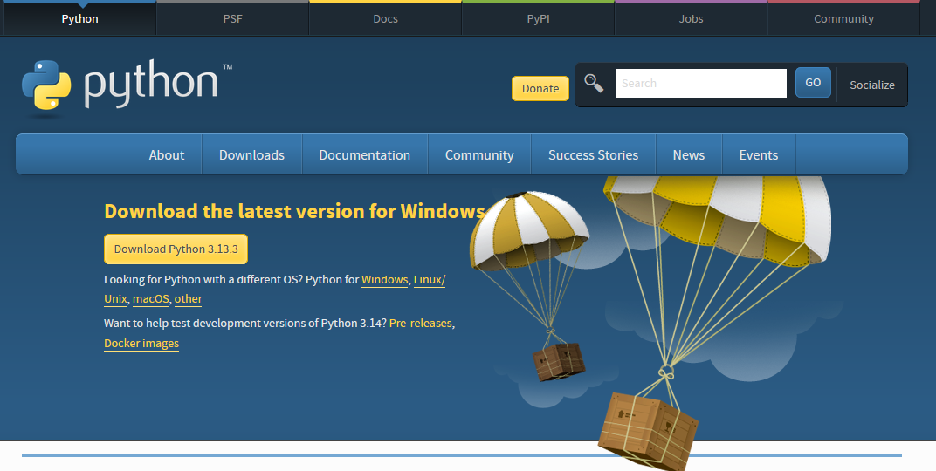
Installation of Python

Slide 5
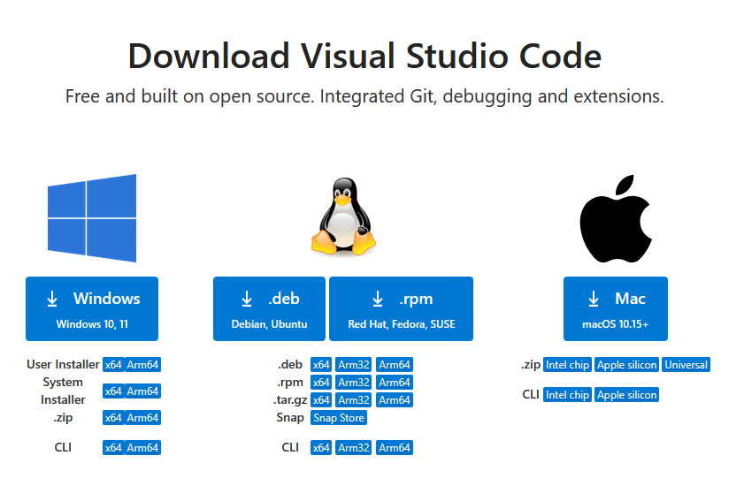
Installation of VS Code

Slide 6
Create A Project
Create New Django Project
django-admin startproject chatbot
Enter Into Your Project
cd chatbot
Create Your First Django App
python manage.py startapp chatapp
Register Your App
INSTALLED_APPS = [
.
‘chatapp’,
.
]

Slide 7
Create A Project
Create Static & Templates Folders
Set Static & Templates Directories
STATICFILES_DIRS = [ os.path.join(BASE_DIR, 'static') ]
TEMPLATES = [{ . 'DIRS': [os.path.join(BASE_DIR, 'templates')], . }]

Slide 8
Requirements
pip install django
pip install -q -U google-genai
pip install genai
pip install SpeechRecognition
pip install pyaudio

Slide 9
Generate Gemini
from google import genai
client = genai.Client(api_key=“abc")
response = client.models.generate_content(
model="gemini-2.0-flash",
contents=sms )
print(response.text)

Slide 10
Generate Gemini Speech
import speech_recognition as sr
r = sr.Recognizer()
with sr.Microphone() as source:
print("Talk")
audio_text = r.listen(source)
print("Time over, thanks")
try:
print("Text: "+r.recognize_google(audio_text))
except:
print("Sorry, I did not get that")

Slide 11


Realistic Infotech Group
IT Training & Services
No.79/A, First Floor
Corner of Insein Road and Damaryon Street
Quarter (9), Hlaing Township
Near Thukha Bus Station
09256675642, 09953933826
http://www.rig-info.com

